Slide 1


Laplace Transforms
HMMWV Mechanical Analysis
12/8/2008
Team Carpe Noctem
Carlos Lazo
Christopher Rappa
Jake Tisdale
Michael Sangillo

Slide 2
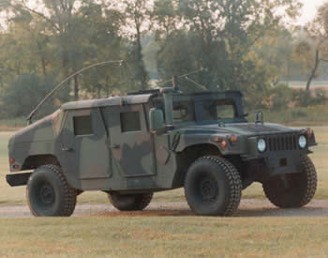
Problem Statement
Our team has been asked to analyze a piece of electrical equipment mounted to a HMMWV. The circuitry is failing due to the excessive mechanical vibration. The current system sees the following effects:
  350 lbf loads
  22’’ displacement
We want to fall within the following customer requirements:
Requirements
  Max sway space is 0.25”
  Max permissible force is 100 lbf
HMMWV (High-Mobility Multipurpose Wheeled Vehicle)

Slide 3
System Diagram
The MKS (meter, kilogram, second) system will be used throughout this presentation.
Our mechanical system can be modeled as a spring-mass-damper system as seen below:
Electronics Box
M = 5.6699kg
X₂ (electronics displacement)
Damper B = 1.23948 Ns/m
Spring Stiffness K = 2709.57 N/m
X₁ (truck bed displacement)
We will be using this model to develop our differential equations.

Slide 4


Part 1 – Derive the Differential Equation of the System
Electronics Box
M = 5.6699kg
Assume the following initial conditions:
  System is at rest
  x₁ and x₂ begin at their local zero positions
Establish the following system parameters:
mass = m = 5.6699 kg
spring constant = k = 2709.57 N/m
damper constant = b = 1.23948 N*s/m
X₂ (electronics displacement)
Damper B = 1.23948 Ns/m
Spring Stiffness K = 2709.57 N/m
X₁ (truck bed displacement)
Using known physics equations, we develop the differential equation for our mechanical system:
Requirement:
  Derive differential equation

Slide 5


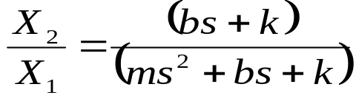
Part 2 – Derive Transfer Function
Start by separating the x₁ and x₂ variables.
Take the Laplace transform of the equation above:
Factor and separate the equation into X₂ and X₁ variables:
Derive the transfer function from X₂ to X₁ through algebraic division:
Requirement:
  Derive Transfer Function by taking the Laplace Transform of the differential equation

Slide 6

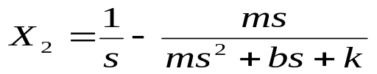
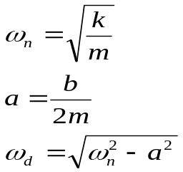
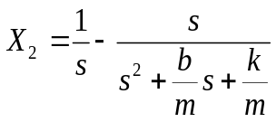

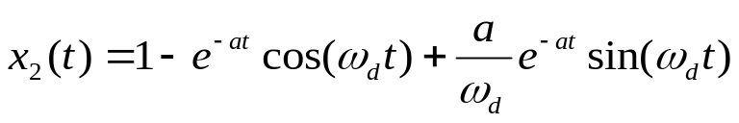
Part 3 – Hand Calculation (Step Input)
Begin by analyzing the system when a step input is applied in the Laplace domain:
Using Partial Fraction Expansion (PFE), we derive our coefficients and rewrite our initial equation:
Forcing the denominator to be of the form (s+a)²+ω_{d}², we make the following definitions and substitutions:
Using known inverse Laplace transforms, we convert our function back to the time domain:
Requirements:
  Calculate system response to step function.
    Apply step input, take the inverse Laplace transform to get x2(t)
      Use partial fraction decomposition and Laplace transform pair table
  Calculate system response to ramp function
    Apply ramp input, take the inverse Laplace transform to get x2(t)
      Use partial fraction decomposition and Laplace transform pair table

Slide 7
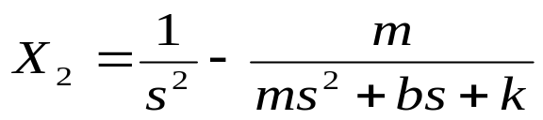

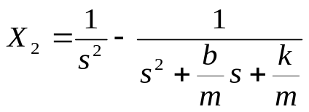
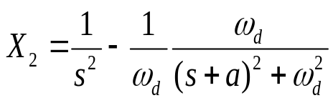
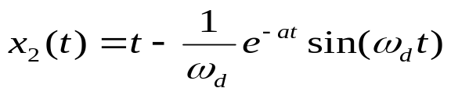
Part 3 – Hand Calculation (Ramp Input)
Begin by analyzing the system when a ramp input is applied in the Laplace domain:
Using Partial Fraction Expansion (PFE), we derive our coefficients and rewrite our initial equation:
Forcing the denominator to be of the form (s+a)²+ω_{d}², we make the following definitions and substitutions:
Using known inverse Laplace transforms, we convert our function back to the time domain:
Requirements:
  Calculate system response to step function.
    Apply step input, take the inverse Laplace transform to get x2(t)
      Use partial fraction decomposition and Laplace transform pair table
  Calculate system response to ramp function
    Apply ramp input, take the inverse Laplace transform to get x2(t)
      Use partial fraction decomposition and Laplace transform pair table

Slide 8
Part 4 – MATLAB Transfer Function Model
Since we ultimately want to make comparisons between the different solution methods,
we derive two different transfer function in MATLAB → the first with a unit step input, and the second with a ramp input.
MATLAB Transfer Function Code:
nums = [B k];
dens = [M B k];
t = 0:tr:tm;
Ts = tf(nums,dens);
[mags,phases,ws] = bode(Ts);
x2sm = step(Ts,t);
x2rm = lsim(Ts,t,t);
MATLAB STEP and LSIM functions used to develop the transfer functions as described.
Requirements:
  Use TF to create a MATLAB transfer function
  Apply a step input using the STEP function
  Apply a ramp input using the LSIM function

Slide 9


Part 5 – Simulink Model (Step & Ramp)
Since we ultimately want to make comparisons between the different solution methods,
we derive two different transfer function in Simulink → the first with a unit step input, and the second with a ramp input.
Step Simulink Model
Ramp Simulink Model
As seen, the resulting Simulink models are exported to the MATLAB workspace to be used in future calculations.
Requirements:
  Construct 3 Simulink models
    Construct the transfer function version
      Consists of input, transfer function block, and output
        1 Model for step
        1 Model for ramp
    Construct the physics version
      Consists of a representation of F=ma
        can’t do step because velocity > ∞
        1 Model for ramp

Slide 10
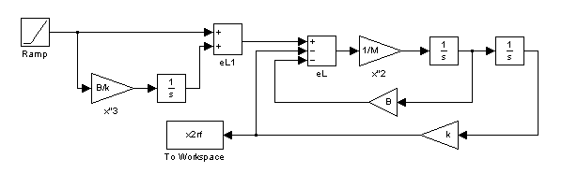
Part 5 – Simulink Model (Physics)
In order to provide a greater sense of intuition into the state of the system,
we derive the physics model of our ramp input differential equation in Simulink.
Ramp Physics Simulink Model
The ramp input is modeled as a feed forward system.
As seen, the resulting Simulink model is exported to the MATLAB workspace to be used in future calculations.
Requirements:
  Construct 3 Simulink models
    Construct the transfer function version
      Consists of input, transfer function block, and output
        1 Model for step
        1 Model for ramp
    Construct the physics version
      Consists of a representation of F=ma
        can’t do step because velocity > ∞
        1 Model for ramp

Slide 11
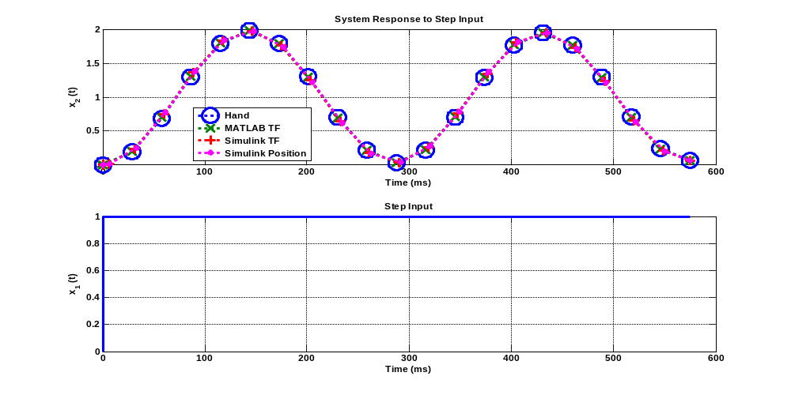
Part 6 – Compare Results (Step)
As it can be seen, the three different methods derived for calculating the step response of our system are almost identical.
Requirement:
  Plot the 3 results of the step input on 1 graph
  Plot the 4 results of the ramp input on 1 graph

Slide 12
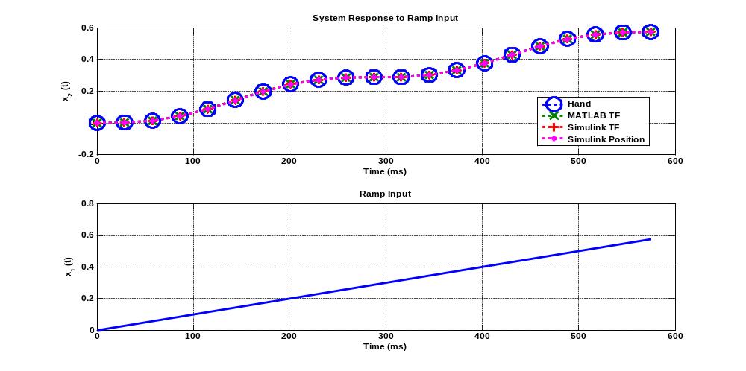
Part 6 – Compare Results (Ramp)
As it can be seen, the four different methods derived for calculating the ramp response of our system are almost identical.
Requirement:
  Plot the 3 results of the step input on 1 graph
  Plot the 4 results of the ramp input on 1 graph

Slide 13




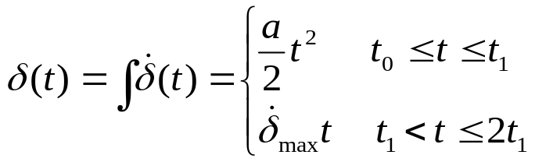


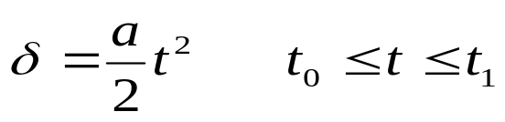
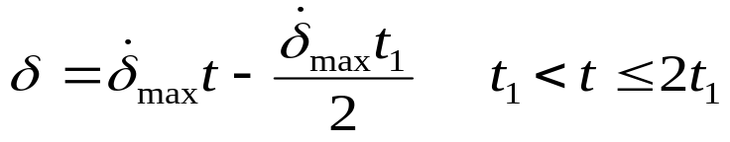
Part 7 – Mathematically Describe Complex Input
In order to describe our new input as a function of the sinusoidal terrain, we start by making the following definitions:
We now find the displacement of the HMMWV by integrating the velocity expression between our given time frames:
Since at time t₁ we are already at a specific displacement,
we account for this by adjusting the second term knowing that t₂ = 2*t₁:
Requirements:
  Derive a mathematical expression for dx/dt

Slide 14
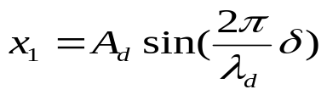
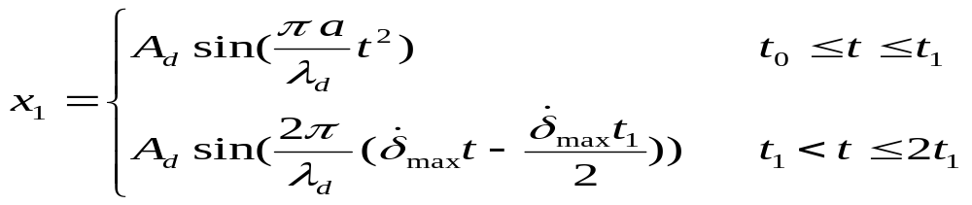
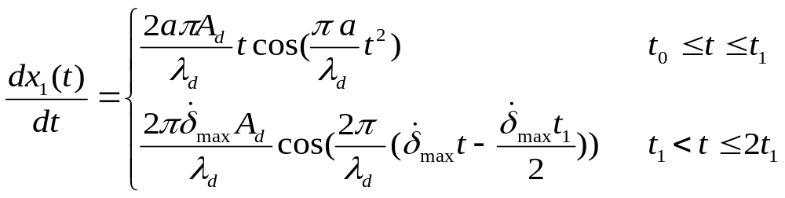
Part 7 – Mathematically Describe Complex Input (Cont.)
Define the x₁ term as the following mathematical expression:
We now substitute the expressions derived previously into the x₁ expression:
By taking the derivative of this new formula, we determine our dx/dt term:
Requirements:
  Derive a mathematical expression for dx/dt.

Slide 15
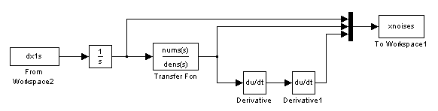
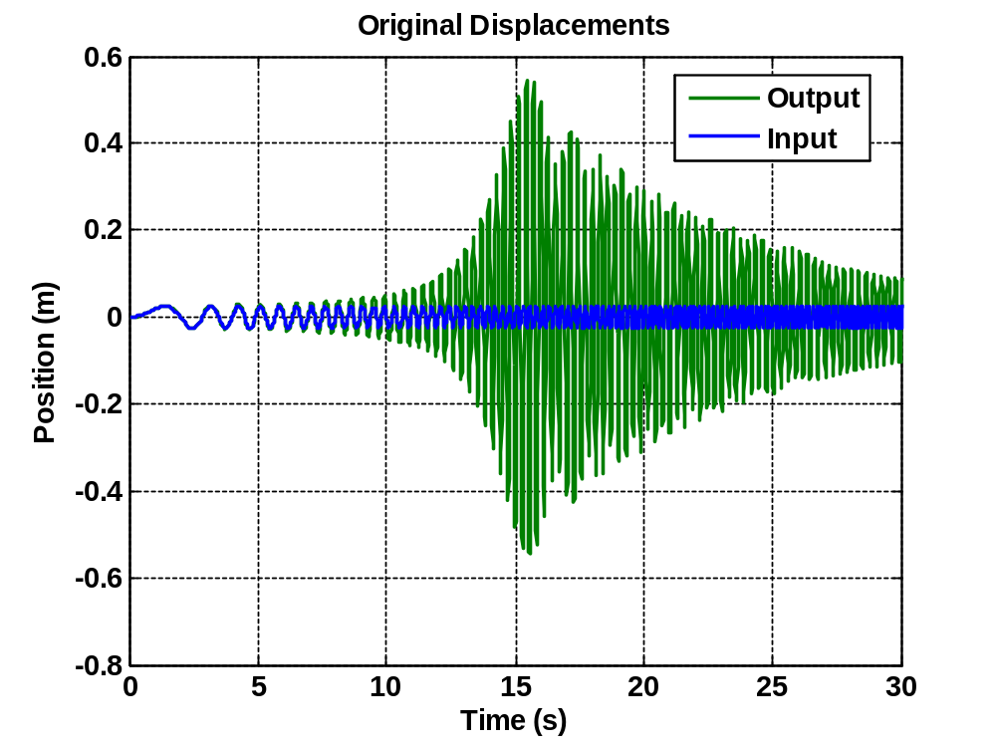
Part 8 – Use Simulink to Simulate Complex Input
We used the following Simulink model to bring x₁ and x₂ into the workplace.
This simulink diagram also stores the acceleration of the time system at each time step.
We now plot x1(t) and x2(t) on the same plot,
as seen to the right:
Input = x₁(t)
Output = x₂(t)
Requirement:
  Simulate terrain input with Simulink
  Plot x1(t) and x2(t) on the same plot

Slide 16
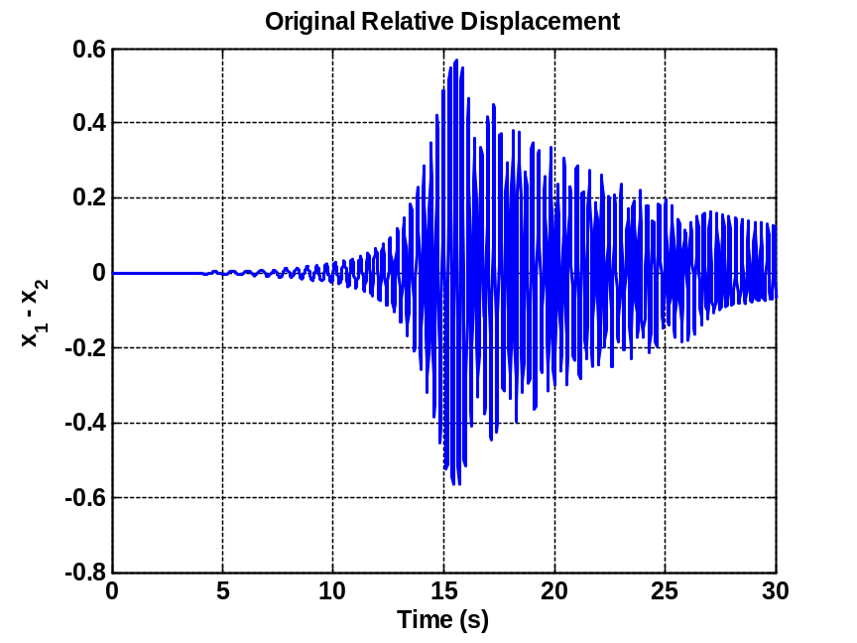
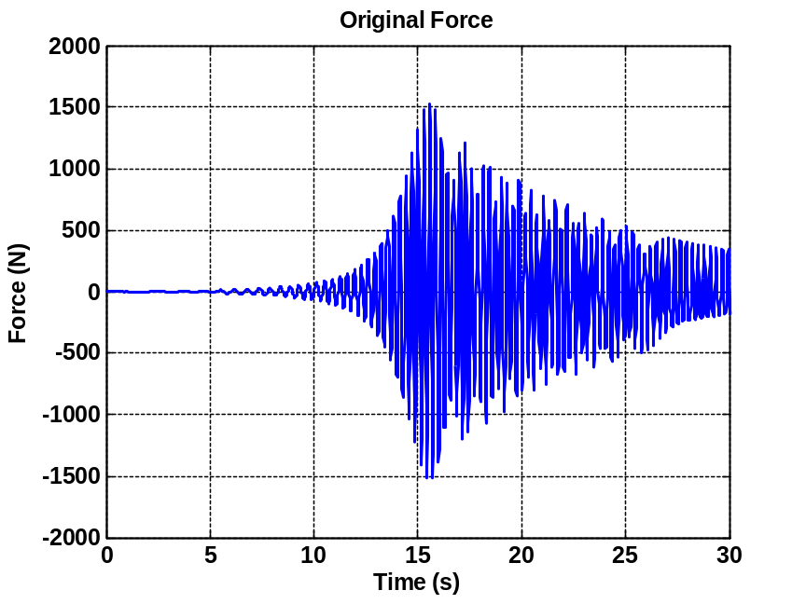
Part 9 – Determine Relative Displacement & Force
We now plot the relative displacement and force seen in our original system:
This graph violates our displacement constraint of
.00635 m (.25 in)!
This graph violates our force constraint of
444.822 N (100 lbf)!
Requirement:
  Plot the relative displacement.
    The relative displacement should violate the sway space requirement.
  Plot the force.
    The force should violate the max permissible force requirement.

Slide 17
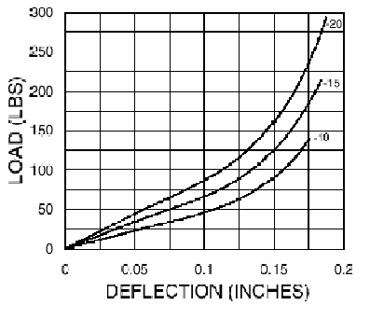
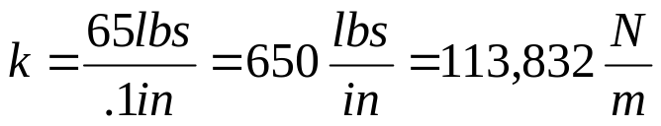
Part 10 – Determine a New Isolator
Since our current system violates the stated requirements, we begin the process of determining a new isolator.
We think that the T44-AB-15 Barry Control vibration isolator will suffice.
Looking at the specifications of this isolator, we use the load vs. deflection curve.
In using a straight line approximation (SLA), we use the -15 curve of the graph ignoring the non-linear parts.
With the red line representing our SLA from 0 – 0.25 inches, we find the new spring constant k:
Requirement:
  Use the Barry Controls design guide and catalog to estimate K and B for the T-44-AB-15 isolator.

Slide 18
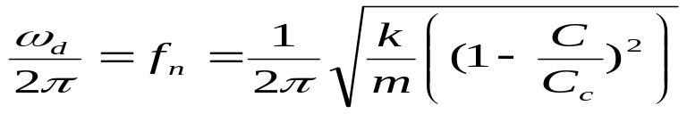
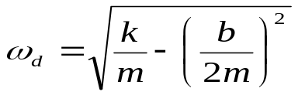

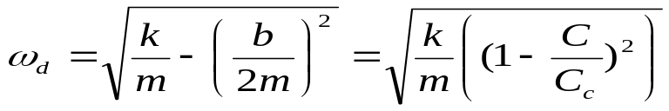
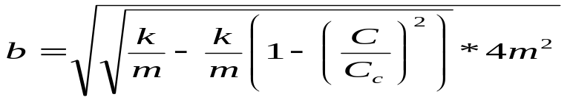
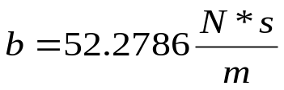
Part 10 – Determine a New Isolator (Cont)
Now that we have a new spring constant, we can determine our damping constant.
This is done through the relationship provided by the following equation:
(1)
Recalling from our transfer function derivation of the following definition:
(2)
We can equate both of the ω_{d} terms in (1) and (2) and solve for b, the damping constant:
Requirement:
  Use the Barry Controls design guide and catalog to estimate K and B
  for the T-44-AB-15 isolator.

Slide 19
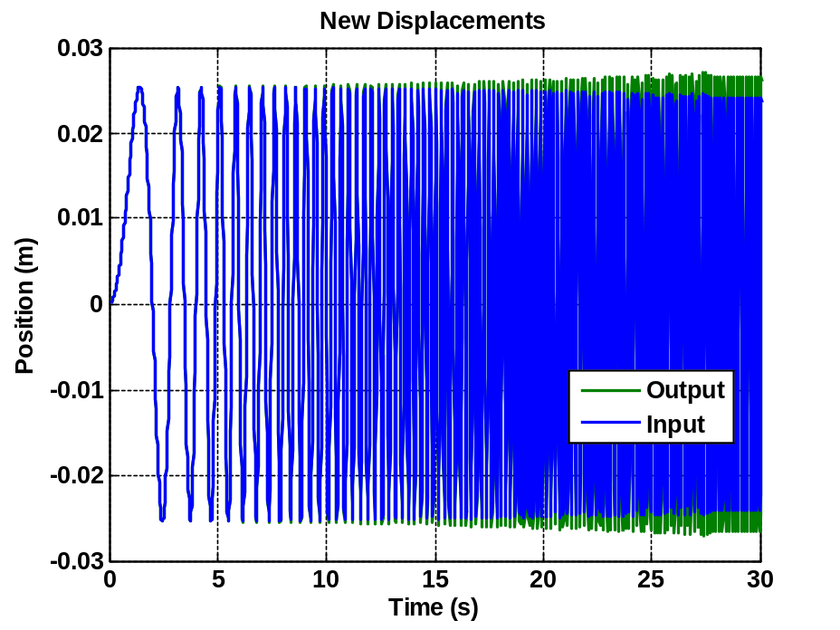
Part 11 – Simulate System with New Isolator
We used the following Simulink model to bring x₁ and x₂ into the workplace.
This simulink diagram also stores the acceleration of the time system at each time step.
We now plot x1(t) and x2(t) on the same plot,
as seen to the right:
Input = x₁(t)
Output = x₂(t)
NOTE
This graph shows us that the input and output are now
almost completely identical. This means that ultimately,
the relative displacement is less than the original system.
Requirement:
  Use Simulink to simulate system with new isolator.
  Plot x1(t) and x2(t) on the same plot.

Slide 20
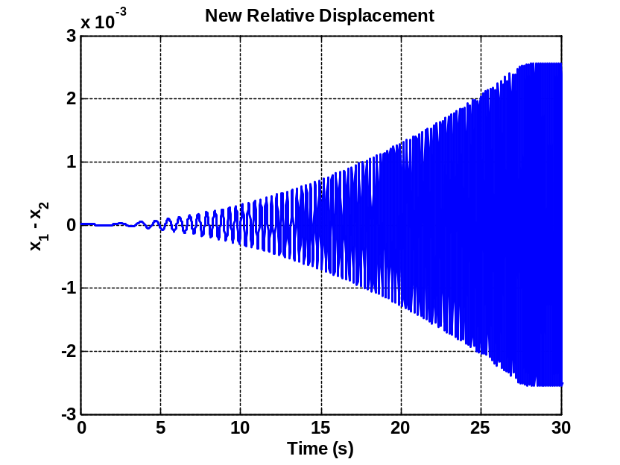
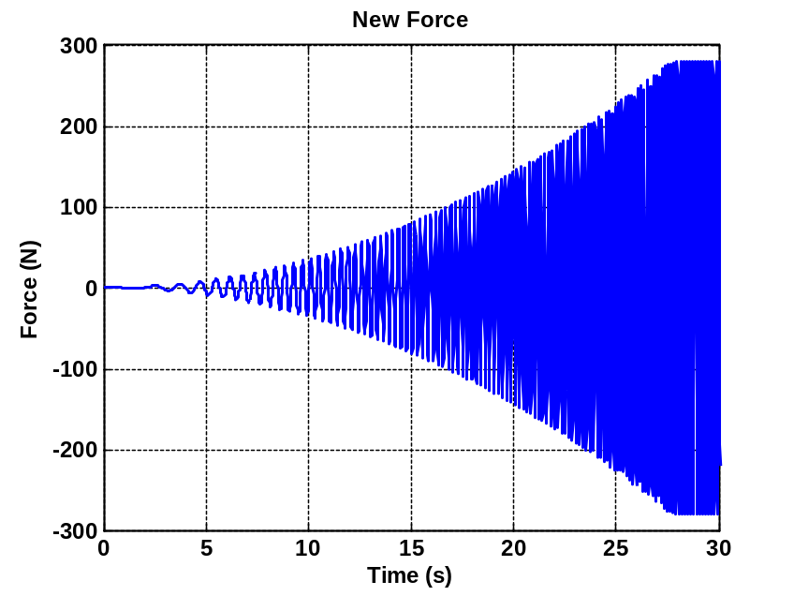
Part 11 – Simulate System with New Isolator (Cont.)
We now plot the relative displacement and force seen in our new system:
This graph MEETS our displacement constraint of
.00635 m (.25 in)!
This graph MEETS our force constraint of
444.822 N (100 lbf)!
Requirement:
  Plot the new relative displacement and verify that it now meets specification.
  Plot the new force and verify that it now meets specification.

Slide 21
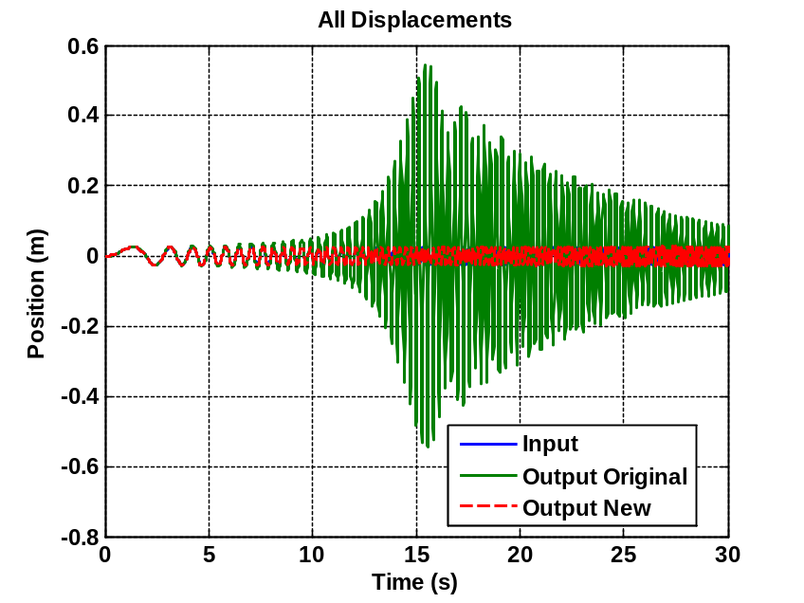
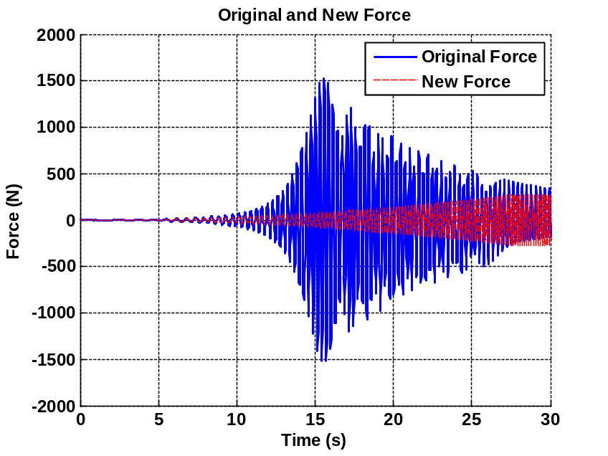
Part 12 – Compare the Two Responses
This graph shows that the input is almost identical to the new output produced by the new isolator.
This graph shows that the force produced by the new isolator is far less than that of the original system.
Requirements:
  Plot the input x1(t), and the two outputs x2(t) (the non-isolated and the isolated response) on the same plot.
  Plot the force transmitted to the box for the non-isolated and the isolated case on the same plot.

Slide 22
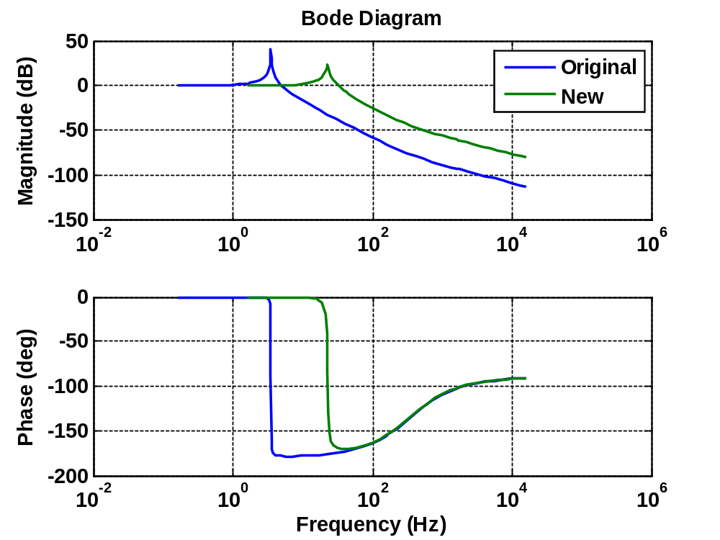
Part 13 – Create Bode Plots
Looking at this the original vs. new system Bode Plots, it is clear that our system
removes resonance from our frequencies of interest by shifting the resonance range to higher frequencies.
The isolated system no longer has resonance in the band that we expect the HMMWV to operate in.
Requirement:
  Use the BODE function on your MATLAB TF models to get the Bode plot of both systems.
  Plot both Bode magnitudes on the same plot to show how the resonance is removed from our frequencies of interest.

Slide 23
Conclusion
1) Through many different analysis methods, our group has determined that the current mechanical system cannot perform to the given system requirements.
2) In replacing our isolator with a T44-AB-15 Barry Control vibration isolator, we are able to successfully meet all requirements as stated for the HMMWV electrical/mechanical assembly.
3) We represented our system with a non-linear spring constant k. This can be seen due to the fact that our system never operates in the non-linear k range where the deflection is > 0.1 inches (as seen in the load vs. displacement graph).

